Slide 1
Layout Managers
Layout manager- An interface class that is part of the JDK
  Aligns your components so they neither crowd each other nor overlap
  Can assign layout managers within layout managers
  For example:
    One layout manager arranges components in equally spaced columns and rows

Slide 2
Defaults
Panel = FlowLayout
Applet = FlowLayout
Frame = BorderLayout

Slide 3
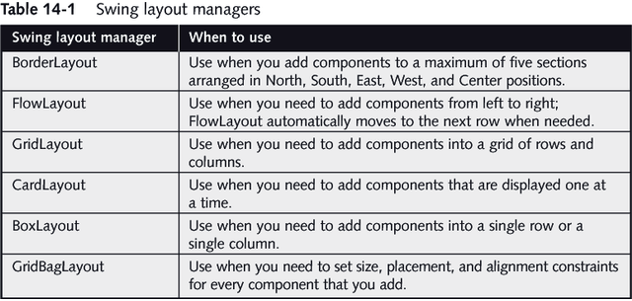
Layout Managers

Slide 4
BorderLayout Managers
BorderLayout manager- The default manager for all content panes
  Can use the BorderLayout class with any container that has five or fewer components
  Components fill the screen with five regions named North, South, East, West, and Center
  The compiler determines the exact size of each component based on the components contents
  When BorderLayout is used with less than five components, any empty regions disappear

Slide 5
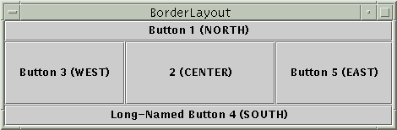
BorderLayout
Five areas
  NORTH, SOUTH, EAST, WEST and CENTER
  Not all areas must be used
  Do not assume a default area for components
  Centre gets as much area as possible
Specify location as argument of add method
  pane.setLayout(new BorderLayout());
  pane.add(new JButton(“Button 1 (NORTH)”), BorderLayout.NORTH);
Setting gaps between components (default = 0)
  BorderLayout.setHgap(int gap);
  BorderLayout.setVgap(int gap);
  BorderLayout(int horizontalGap, int verticalGap) - Constructor

Slide 6
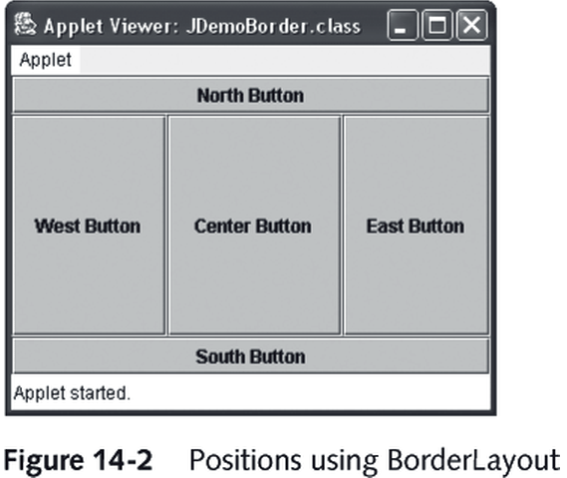
Positions using the BorderLayout

Slide 7
FlowLayout Manager
Default type for Panels and Applets.
A lot like a word processor:
  Arranges components in horizontal rows.
  Components “wrap” to the next line if they don’t fit across.
  Each component retains its default size
Specify in constructor:
  FlowLayout.LEFT, FlowLayout.CENTER, FlowLayout.RIGHT

Slide 8
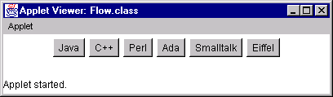
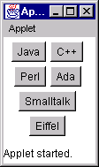
Flow Layout
- To arrange Components in rows across the width of a container
- Each component that you add is placed to the right of previously added components
width=400 height=50
width=100 height=120
CS 3331

Slide 9

FlowLayout
Very simple - JPanel’s default
Components in row(s)
At preferred size
Alignment
  FlowLayout.LEFT
  FlowLayout.CENTRE
  FlowLayout.RIGHT
Gaps
  Default = 5
  Specifying - setter hGap vGap methods or via constructor

Slide 10
GridLayout Managers
GridLayout- To arrange Components into equal rows and columns
GridLayout( rows, columns )
  You indicate the numbers of rows and columns you want, and then the container surface is divided into a grid
  Specify rows first, columns second
  As you add components they are positioned left-to-right across each row in sequence

Slide 11
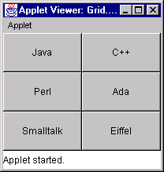
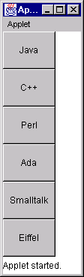
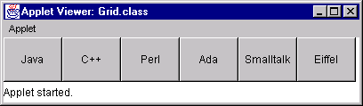
Grid Layout
3x2 grid
0x1 grid
1x0 grid

Slide 12
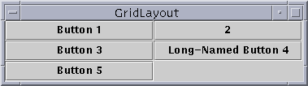
GridLayout
Grid of cells - all same size
Components take all space in a cell
Gaps
  default = 5
  use setter methods hGap and vGap
  or via arguments to constructor
Re-sizing
  Cells resize to be as large as possible in given window / container

Slide 13
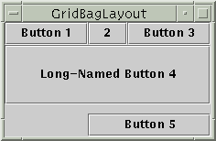
GridBagLayout
Very flexible (and complex!)
Rows can have different heights
Columns can have different lengths
Uses cells in a grid
GridBagLayout gridbag = new GridBagLayout();
GridBagConstraints c = new GridBagConstraints();
JPanel pane = new JPanel();
pane.setLayout(gridbag);
//--- For each component to be added to this container:
//--- ...Create the component...
//--- ...Set instance variables in the GridBagConstraints instance...
gridbag.setConstraints(theComponent, c);
pane.add(theComponent);

Slide 14
GridBagLayout
Constraints
  set in an instance of a gridBagConstraints Object
  gridx and gridy - The row and column of the upper left of the component
  Anchor - Where to display within cell when component is smaller than it
  fill - How to size component when cell is larger than components requested size
  insets - External padding - min space between component and cell edges
  ipadx, ipady - Internal padding - What to add to min size of components
  weightx and weighty - How to distribute extra space (padding)
  gridwidth and gridheight - Number of columns or rows the component uses

Slide 15
GridBagLayout- Allows you to add components to precise locations within the grid, as well as to indicate that specific Components should span multiple rows or columns within the grid
This class is difficult to use because you must set the position and size for each component

Slide 16
Card Layout Managers
CardLayout- Generates a stack of containers or components, one on top of another
Each container in the group is referred to as a card
Only one component is visible at a time
A card layout is created from the CardLayout class using one of two constructors
  CardLayout() creates a new card layout without a horizontal or vertical gap
  CardLayout(int hgap, int vgap) creates a new card layout with the specified horizontal and vertical gaps

Slide 17
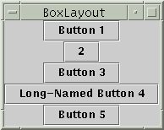
BoxLayout
Components on top of/ next to each other
  Direction is your choice
Tries to size components at preferred height for Y_AXIS or width for X_AXIS
Width as largest component width
  See above picture

Slide 18





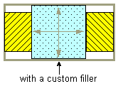
BoxLayout
Space fillers
  Rigid - fixed-size space between two components
  Glue - taking up no space unless you pull apart the components that it's sticking to. Helps reposition extra space (default is at end)
  Custom - Use this to specify a component with whatever minimum, preferred, and maximum sizes you want

Slide 19
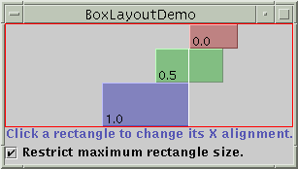
BoxLayout
Component sizes
  Respects Max, Min and Preferred Sizes of components
Alignment
  Comes into play when not all components are the same width
  Can specify Left (0), Centre (0.5) or Right (1). Or Top Middle Bottom
If you are having layout problems, first treat as an Alignment issue, then examine sizes.

Slide 20
BoxLayout- Components are arranged in either a single row or a single column
The box layout manager tries to make all the components the same height(row) or width(column) so components do not spill over

Slide 21
BoxLayout
Requires two arguments
  The first refers to the container to which the layout manager applies
  The second is a constant
    BoxLayout.X_Axis for a row arrangement
    BoxLayout.Y_Axis for a column arrangement

Slide 22
Using JPanels
JPanels- Increase the number of possible component arrangements by using the JPanel class
A JPanel is similar to a JWindow in that a JPanel is a surface on which you can place components
JPanel is a Container so it can contain other components
By using JPanels within JPanels, you can create an infinite variety of screen layouts

Slide 23
JPanel
Frame
Panel
Panel
Panel
Panel
Label
Label
Label
Text Field
Text Field
Text Field
Scrollbar
Scrollbar
Scrollbar
Panel
Button
Button
Button

Slide 24
Using JPanels
JPanel object constructors
  JPanel() creates a new JPanel with a double buffer and a flow layout
  JPanel(LayoutManager layout) creates a new buffered JPanel with the specified layout manager

